Slide 1
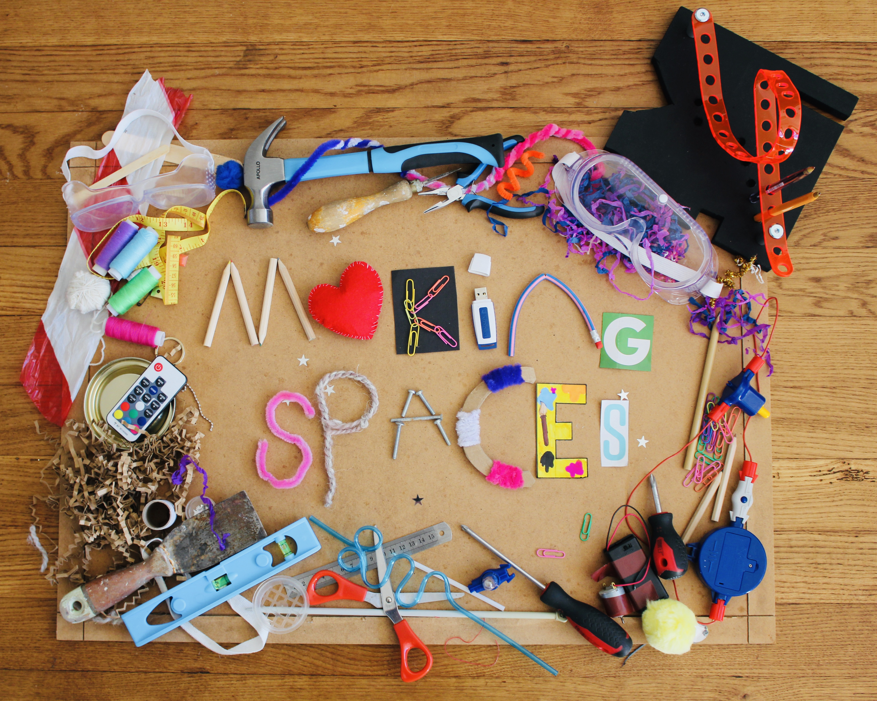
Social Justice and Inequalities in STEM Education: How can we support more inclusive and engaging STEM education?
Engaging young people with STEM: A Science Capital approach
Louise Archer
Karl Mannheim Professor of Sociology of Education
UCL Institute of Education

Slide 2
The challenge for STEM education
Despite massive investments of time and resources to widen (and increase) participation, science/STEM participation remains dominated by privileged people (e.g. White, male, middle-class, able-bodied, etc.)
Most efforts have focused on changing young people in some way, often through deficit models (e.g. to change/increase a perceived ‘lack’ of interest, motivation, awareness, knowledge)
But our research suggests that (i) lack of interest and motivation is not the main issue and (ii) schools and science education play a role in excluding and dissuading students from science

Slide 3
ASPIRES research
Since 2009 the ASPIRES project has undertaken large-scale surveys (40,000+ young people to date), and in-depth tracking of 50 students and their parents (age 10-21) (700+ interviews)
Student surveys and interviews at ages 10/11 (Y6), 12/13 (Y8), 13/14 (Y9), 15/16 (Y11), 17/18 (Y13) and age 20/21
Lack of interest in science is not the main issue …

Slide 4
Most like science - but few aspire to be science careers
* Only asked of Y13 students studying at least one science A level
** Y13 data is weighted to national A level science entries
Notes:
I just changed to legend for Y11 – the age is 15/16, not 14/15 as in the original slide – whoops! (just in case you want to change it on any of our other presentations!)

Slide 5
What careers do students aspire to?

Slide 6
Key factors shaping science aspirations and participation age 10-19
Full (2019) report: https://discovery.ucl.ac.uk/id/eprint/10092041/15/Moote_9538%20UCL%20Aspires%202%20report%20full%20online%20version.pdf

Slide 7
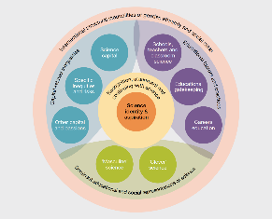
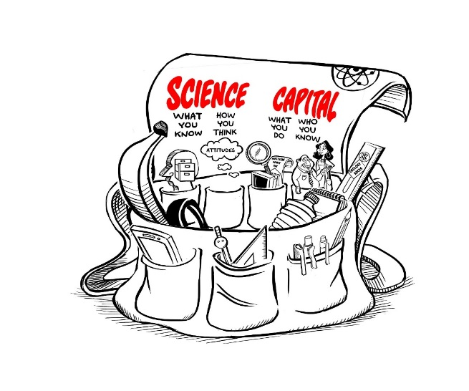
Science capital
Developed in ASPIRES project and since extended
‘Science capital’ is a ‘conceptual holdall’, combining socialised dispositions and science-related cultural and social capital
Students whose science capital is valued and realised are significantly more likely to aspire to and participate in post-16 science and have a ‘science identity’

Slide 8
Main dimensions of science capital
Science literacy (“what you know”)
Science-related attitudes and values (“how you think”)
Out of school science behaviours (“What you do”)
Science at home (“who you know”)
Video Link
https://www.youtube.com/watch?v=A0t70bwPD6Y&t

Slide 9
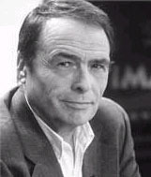
A sociological lens
Interactions of habitus, capital and field produce patterns in science engagement and participation:
Habitus - socialised, embodied dispositions shape whether science is ‘for me’, or not, formed through classed, gendered, racialized experiences: Gives a ‘feel for the game’
Capital – cultural, social economic and symbolic resources possessed and accrued, shaped by social axes: the ‘hand’ you can play in the game
Field – ‘space of positions and position-taking’: the ‘rules’ of the game
Extent of ‘fit’ between habitus, capital and field shapes whether students experience science/ STEM as a ‘fish in water’, (Science families – where science is ‘for me’), or not and produces differential trajectories

Slide 10
Science capital and families
Produces sense of whether science is for ‘people like me’, or not
“The other day in the car we were laughing about chemical symbols and things, so I guess it does come into the discussion quite subliminally really” (Mother).
“Science is just where it’s at in my family” (Davina, student)
“I suppose in everyday life you don’t get that much to do with it [science]” (Mother)
“They never talk about science” (Jack, student)

Slide 11
The field – supporting or limiting the realisation of science capital
Value of a person’s science capital is determined by the field
Different fields provide different affordances (or limitations) for young people to see themselves and be recognised by others for their science engagement (e.g. Carlone study of a US middle-school class over time)
Field plays key part in cultivation of science capital over time and can mitigate home science capital – e.g. the case of Vanessa in ASPIRES

Slide 12
Dominant representations of science: masculinity and ‘cleverness
Pernicious and differential effect on who feels ‘science-y’
E.g. Victor (white, middle-class boy, goes on to Astrophysics degree):
Y6: “You don’t have to be clever to do science”
Y8: “I think you have to be a little clever … yeah, you probably have to be quite clever”
Y9: “People keen on Science … um they’re sort of … they’re not average people, they’re more … they’re more clever, they’re cleverer than most people”
Y11: “Er, yeah, you need it, yes”

Slide 13
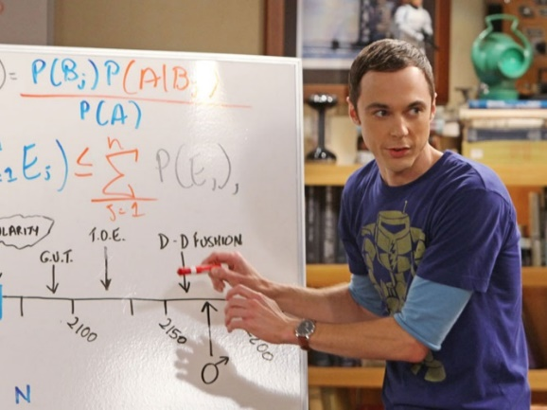
As a result …
Many, even highly interested, young people are stopped/hindered in continuing with science
Many self-exclude (“science is interesting, but not for me”)
Those who continue are the most stereotypical in their views of science …

Slide 14
So what needs to be done?
Change the field, not the young person!
Field = practice, spaces and power relations through which science/STEM is constructed, represented and experienced. Field determines what and who gets valued
Changing the field enables:
More diverse young people’s science capital to be recognised, valued and leveraged
Diverse young people’s needs to be addressed and capital to be supported
Changing the systems, practices and representations that exclude many young people from STEM and make them feel it is ‘not for me’
Connecting STEM more meaningfully with young people and communities
More sustainable change

Slide 15
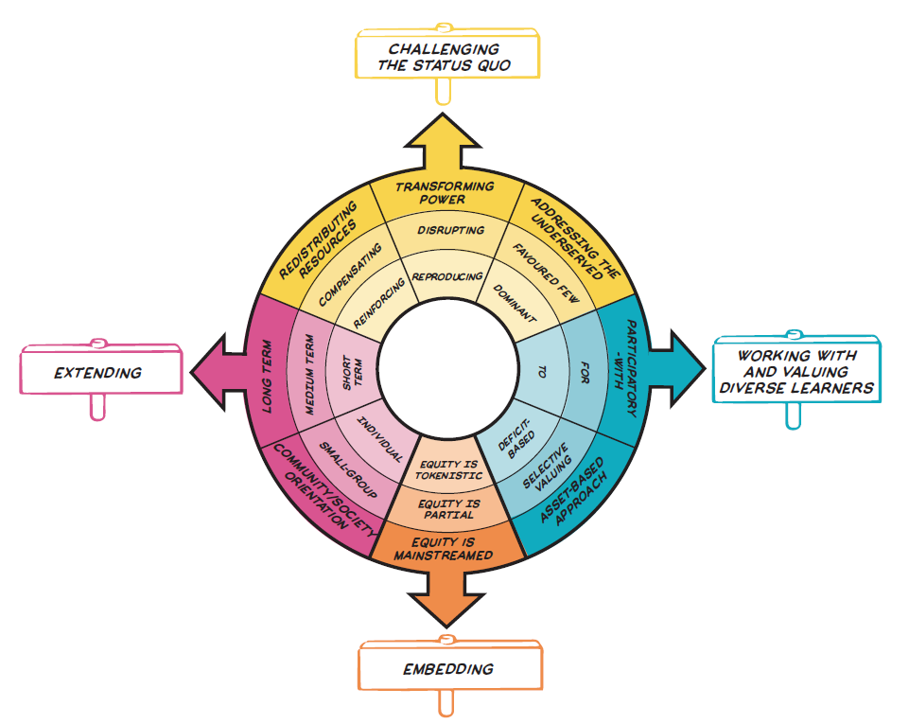
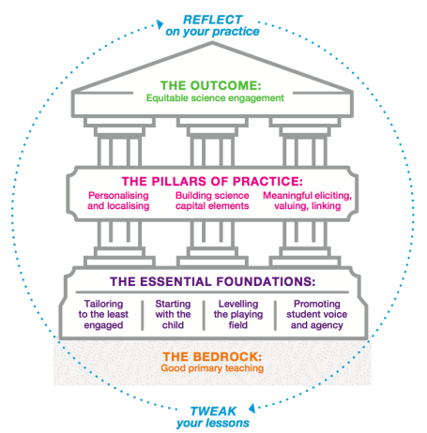
An equitable approach to supporting science engagement
Its not (just) what you do - but the way that you do it!
Underpinning values and mind set will determine the equitable potential of your practice and use of the SCTA
Two elements: the Equity Compass and the Science Capital Teaching Approach
REFLECT
ACT

Slide 16
The Equity Compass
Q. What is it?
A. A reflective tool that supports ISL practitioners to understand, identify and plan for how they might make their practice more equitable
Q. How can it help practitioners?
A. The Compass sets out eight areas, with reflective questions for each, that are useful/ important to think about for equitable ISL practice. You can use the compass to map your progress and help identify further areas for consideration and planning. It also supports your approach to using the SCTA.
https://www.youtube.com/watch?v=WE4ksRCEoyA

Slide 17
Equity Compass –
Four overarching areas

Slide 18
CHALLENGING THE STATUS QUO
Transforming Power (To what extent are dominant relations being reproduced, disrupted or meaningfully transformed? Who has agency, power and legitimacy?)
Redistributing Resources (Are activities mainly supporting the already privileged? How are minoritized communities being supported?)
Prioritising the interests, needs and values of minoritized communities (Whose interests, needs and values drive the policy and/or practice?)
S

Slide 19
WORKING WITH AND VALUING MINORITIZED COMMUNITIES
Participatory practice (Is science being done ‘to’, ‘for’ or ‘with’ underserved young people and communities? How are youth identity and agency being supported?)
Assets-based approach (How are the interests, knowledge, identities and resources of minoritised youth and communities being recognized and valued in the learning?)
S

Slide 20
EMBEDDING EQUITY
Equity is mainstreamed (How central, major, intentional and foregrounded are equity issues in the programme and organisation? Is equity issues everyone’s core business?)
S

Slide 21
EXTENDING EQUITY
Collective orientation (To what extent does the practice contribute to individual or wider collective outcomes?)
Long-term (Is the practice short term/one-off, medium term or long term? Is attention being paid to supporting young people’s trajectories and progression over time and across contexts?)
S

Slide 22
Compass helps us to:
Recognise and think about 8 key dimensions of equity/ social justice
Use reflective questions to guide our thinking
Consider how equitable practices and outcomes are
Map where we are – and map our progress (moving from inside outwards)
Get the right mind set for using the SCTA

Slide 23
Equity Compass
Map and reflect on your practice
L

Slide 24
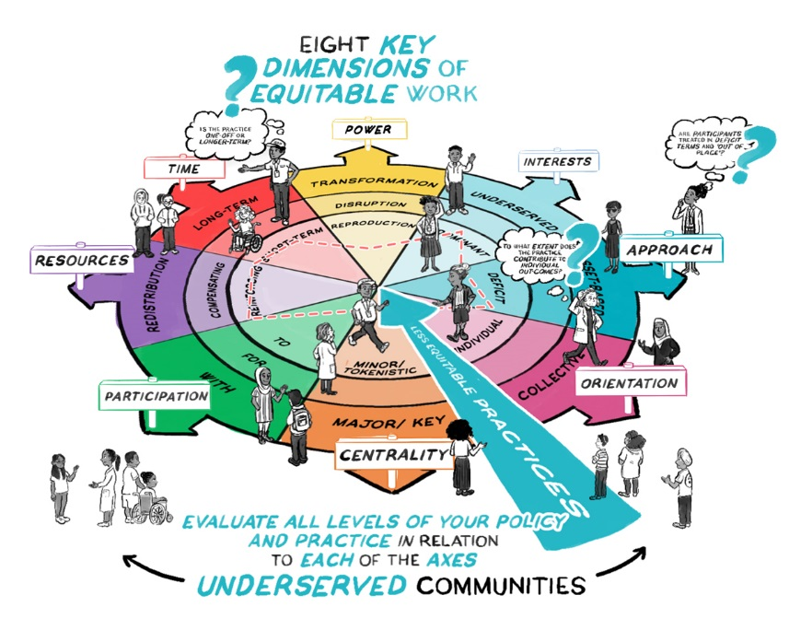
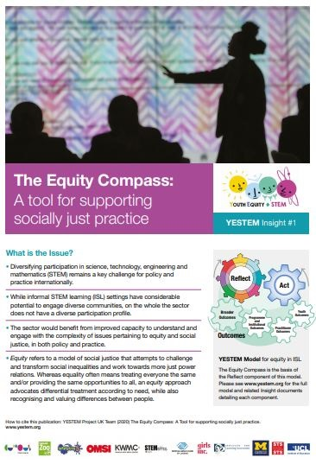
2 minute explanatory animation:
https://www.youtube.com/watch?v=WE4ksRCEoyA
Summary publication for practitioners
http://yestem.org/wp-content/uploads/2020/10/EQUITY-COMPASS-YESTEM-INSIGHT.pdf
Applying with ISL educators (YESTEM project) and primary teachers (Primary Science Capital Teaching Approach project)

Slide 25
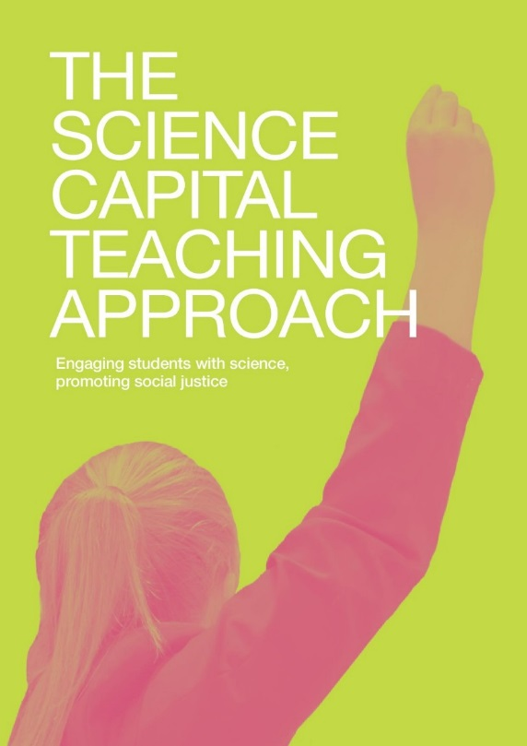
The Science Capital Teaching Approach

Slide 26
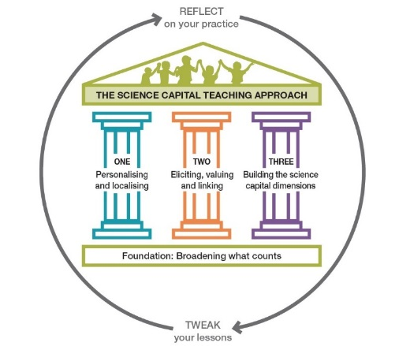
SCTA: Changing the field
Builds on existing good teaching practice
Works with any curriculum
Key principles - improving students’ relationships with science, changing the field, not the young person
Originally developed with secondary (Enterprising Science project), now being developed with primary (PSTT/Ogden project) and with the informal sector

Slide 27
Development of SCTA
Originated in collaborative R&D work with secondary schools (over 4 years with 40+ teachers from schools in 4 cities)
Evidence from 2x year long trials showed significant increases in secondary students’ science capital, attitudes to science and post-16 science aspirations
Current project is co-developing the approach with primary teachers
Also working with informal educators to refine and apply
Focus on changing practice – not changing the young person (e.g. how engagement is organised, who has power, issues of representation, valuing what participants bring with them)

Slide 28
Primary SCTA website (for new handbook – due Oct 2021!)
https://www.ucl.ac.uk/ioe/PrimarySciCap
SCTA Handbook and resources:
https://www.ucl.ac.uk/ioe/departments-and-centres/departments/education-practice-and-society/stem-participation-social-justice-research/science-capital-teaching-approach

Slide 29
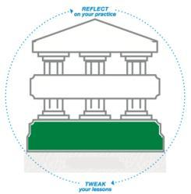
Foundation: Broadening what and who counts
Young people do not just find science concepts difficult – some struggle to identify and engage with science, it feels alien to them
Challenge stereotypes and dominant ideas and representations of science, such as ‘who does science’ and what constitutes ‘doing’ science

Slide 30
Foundation: Broadening what counts
Start with (centre) the child/ participant
Child-centred planning and teaching, focusing in particular on recognising and valuing the identities, needs, experiences and contributions of children from historically excluded and minoritised communities and grounding learning within children’s lives.
Foster inclusive science teaching and learning
Ensuring that teaching and learning is representative and inclusive; providing differential support in recognition of need and injustice, ‘lensing’ from the perspective of children from excluded and minoritised communities.
Support voice and agency
Creating a learning environment where young people’s voices are heard and validated. Using their voices to direct the experience so that participants have ownership/agency towards the science topics, organisation and style of learning and can use science learning to take action in their lives and communities

Slide 31
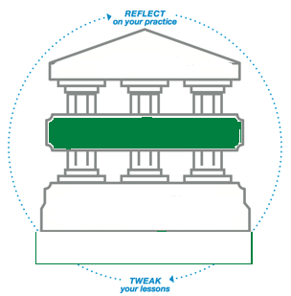
Pillar: Personalise and Localise
Go beyond contextualising science - personalise and localise it to make relevant to your particular students’ everyday lives
Approach looks different in every classroom – because students are different
“If kids can talk about their experience, express themselves or their ideas – I find they’re far more engaged and they value it a lot more.[…] When they’re talking about something that they personally know or care about, you can see they’re happy, they’re excited” (Partner teacher, 2016-2017)

Slide 32
Pillar: Elicit, Value & Link
A technique for helping to broaden what counts and personalise and localise
Way to support participants to feel valued and connected to science
Educators elicit participants’ experiences, skills and home and cultural knowledge (what they ‘bring with them’) in relation to a topic, value (and legitimate) these, and highlight the science connections

Slide 33
Pillar: Building the science capital dimensions
Actively cultivate, develop and build science capital dimensions
E.g. build understanding of how science is everywhere in life; foster the sense that science isn’t hard, or for other people, but can be a part of everyone’s life and conversations.

Slide 34
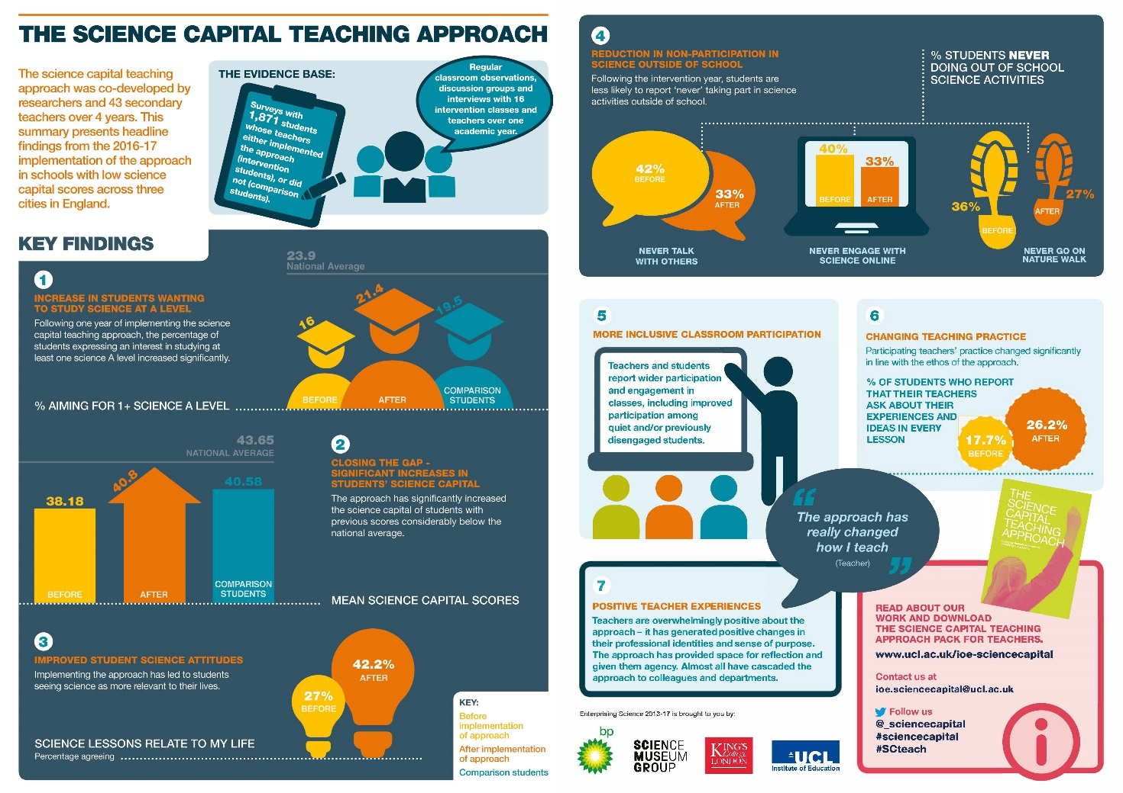
Outcomes - secondary

Slide 35
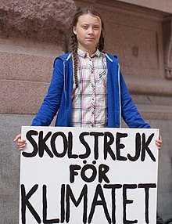
Key features
Approach has proved popular across primary, secondary and informal settings
Trying to help move the focus away from ‘more STEM’ (esp. content knowledge), one-offs, deficit approaches
Key to approach is embedding SC principles in everyday practice
One-off visits have a place, but will not be as effective as participatory, focused, longer-term engagement.
Using SCTA to support and develop young people’ critical STEM agency – taking action on issues that matter to them and their communities

Slide 36
Summing up
The Compass and SCTA can help us think about and enact equitable/socially just STEM engagement practice and help STEM and young people to more meaningfully connect
Key point: changing practice (the field), not the young person
Together, the resources provide tools for practice and can help track progress and support professional reflection and development
Our projects will be publishing a range of resources, publications, etc., for the ISL sector over the coming year

Slide 37
Contact our projects | Twitter | Website
ASPIRES | @ASPIRESscience | https://www.ucl.ac.uk/ioe/departments-and-centres/departments/education-practice-and-society/aspires-research
YESTEM | @yestem_UK | www.ucl.ac.uk/ioe-yestem
Making Spaces | @M4kingSpaces | m4kingspaces.org
Primary Science Capital | @PrimarySciCap | https://www.ucl.ac.uk/ioe/departments-and-centres/departments/education-practice-and-society/science-capital-research/primary-science-capital-project

